Slide 1
Creating Dashboards with Report Center
Building BI Solutions with SharePoint Server

Slide 2
Agenda
The Report Center site template
Creating Dashboards
Key Performance Indicators (KPIs)
Filters

Slide 3
Report Center
With Office 2007, SharePoint Server become the hub for BI on the server
Excel Services and Reporting Services in the portal
Out-of-the-box BI portal experience
Dashboards, KPIs, and Report Libraries
Integrated with Portal, Collaboration, Enterprise Content Management and Workflow functionality
Notes:
Instructor Notes
Second part of the presentation.
Cover the goals here of the Report Center. Stress that it’s goal is to be the place to visit for anybody who wants to do reporting or business intelligence in Office 2007 server.
We deliver Report Center as a site template in Office 2007 server and we immediately create an instance of it and integrate it in the portal you can create.

Slide 4
SQL Server Reporting Services
Integrated with WSS to enable publishing, viewing, and management of reports
Microsoft Office SharePoint Server light up
Report library integration
Dashboards and filter Web Parts
Integration is interesting because…
New capabilities for Reporting Services users
Great example of deep integration for ISVs
Notes:
Instructor Notes
Reports can be created and delivered via SQL Server Reporting Services. How do we integrate in Office 2007 with Reporting Services?
Goal is full integration with WSS and Office 2007 Report Center.
Special library called the Report Library
Web part that can display a report and filter web parts that can be connected to it to slice the data

Slide 5
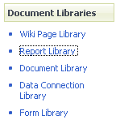
Storing Reports
Reports have more specific needs than documents
History is very important
Many instances of the same report can exist
Therefore, Office Server adds a Report Library template
Displays current spreadsheet / report by default
History available via search and list views
Custom profile page
Can be part of Report Center
A list template that can be used anywhere
Notes:
Instructor Notes
Reports (SQL Server Reporting Services, Excel-based, or something completely else) can be stored in a normal document library. However, there are some specific needs for reports. Maintaining a history is important as well as the fact that you probable want to store different instances of the same report. For example, you can have a sales report generated daily. The report is the same but the data changes.
Talk about how today reports can be stored in WSS v2 -> a document library with an entry per report instance ending up quickly to large document libraries that are not easy anymore to maintain.
To meet these needs, we introduce the Report Library in Office 2007 server - a library containing the necessary functionalities for storing, managing and making report instances available. By default, it shows the current version of the report, but the history is available at any moment. Search will take these instances also in account. Views on these instances can be created.
Reports often contain a lot of metadata storing the context of the report. A profile page can display this metadata when the report instance is visualized to the user.
The Report Center already contains such a library, but you can actually create an instance of the list template anywhere.

Slide 6
Key Performance Indicators
Goals
KPIs can be an important instrument in the organization, so let’s make it easier to create them
And let’s use the environment we already know – the portal and team sites
Support KPI types from simple to enterprise class
Types
Manually entered
SharePoint list
Excel workbook
SQL Server Analysis Services
Technologies
KPI web part & list
Customizable KPI profile page
Dashboard template focused on KPIs
Notes:
Instructor Notes
Introduce Key Performance indicators as instrument in organizations to visualize how well we are doing in various domains (sales, customer satisfaction, …)
OOB, we deliver an initial infrastructure with a KPI web part and list that can be further expanded with a profile page displaying associated metadata . KPI list instances can be parts of a dashboard.
Discuss the four types of KPIs

Slide 7
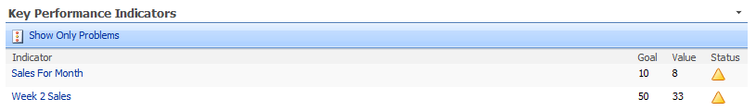
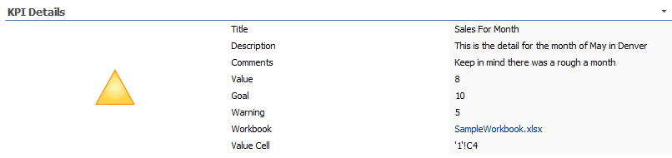
KPI Web Parts

Slide 8
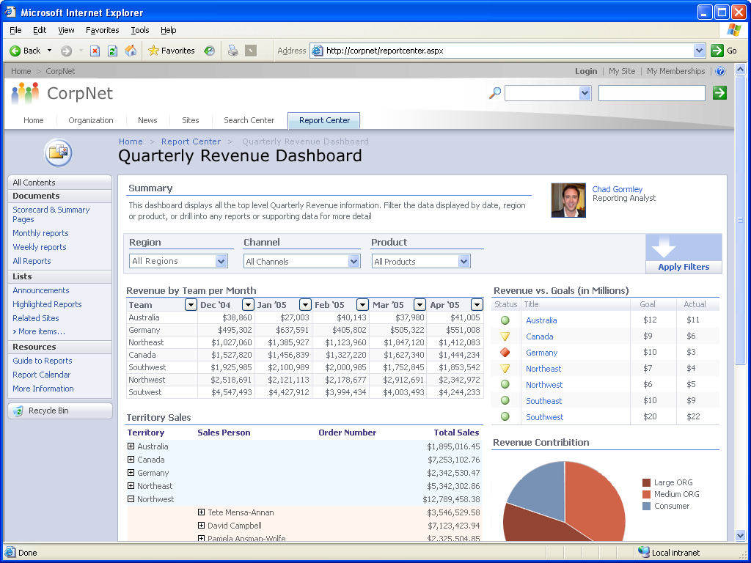
Dashboards
Dashboards are SharePoint pages
Dashboard pages are in same document library as spreadsheets and reports
Types
Generic dashboard
KPI focused
Notes:
Instructor Notes
Template to get you started – 2 types -> KPI / Generic
You fill up the zones with Web parts displaying all kinds of BI components (reports, excel snapshots, filter web parts, …)

Slide 9
Filtering
Filtering is the natural next step after building a dashboard
Filter for eastern region, last quarter
Automatically show just your customers when you load page
Accept values from query string
http://server/dashboard.aspx?Product=452
Notes:
Instructor Notes
Very important on a dashboard. Filtering can be explicit (initiated by the user - eg to drill down in data) or done behind the scenes (eg based on your user profile data - department, responsibilities, region, …)

Slide 10

Filtering Web Parts
Display options
Type in value
Pick from list
Tree view
Hidden
Filter value sources
User entered value
Manual list
SharePoint list
Analysis Services
Bus. Data Catalog
SharePoint profile
Query string
Extensibility
Custom providers & consumers
Standard interfaces that ship in WSS
Notes:
Instructor Notes
Discuss the various display options, possible value resources and then the extensibility.

Slide 11
Summary
The Report Center site template
Creating Dashboards
Key Performance Indicators (KPIs)
Filters

